Slide 1
Planning action sequence with Offline RL
Fast and smooth pre-heat phase in ovens

Slide 2
NO transition dynamics model is needed:

Slide 3
Method I – Open-loop dynamical systems planning control with IRL from batch data
Batch Dataset
Generator
T_demo:
{S_demo, A_demo}
Policy REINFORCE LSTM NN:
S0 -> {a1,a2,a3..} ∊ A_samp
Discriminator
SysModel Seq2seq:
A_samp -> S_samp
Cost FeedForw NN:
T_samp
+ -> R
Tdemo
T_samp:
{S_samp, A_samp}
Unroll policy

Slide 4
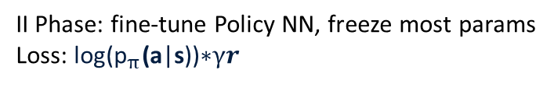
Method II – Open-loop dynamical systems planning control pre-trained from batch data
Policy NN LSTM:
S0 -> {a1,a2,a3..} ∊ A_samp
Use rewards to loss
Batch Dataset
T_demo:
{S_demo[0], A_demo}
SysModel Seq2seq LSTM:
A_samp -> S_samp
Extract hand-crafted rewards
Unroll policy
I Phase: pre-train Policy NN with batch data (one-to-many)
Loss: cross-entropy
II Phase: fine-tune Policy NN, freeze most params
Loss: $\text{log}\text{(}{\text{p}}_{π}\text{(}\text{a}\text{|}\text{s}\text{))∗}γr$

Slide 5
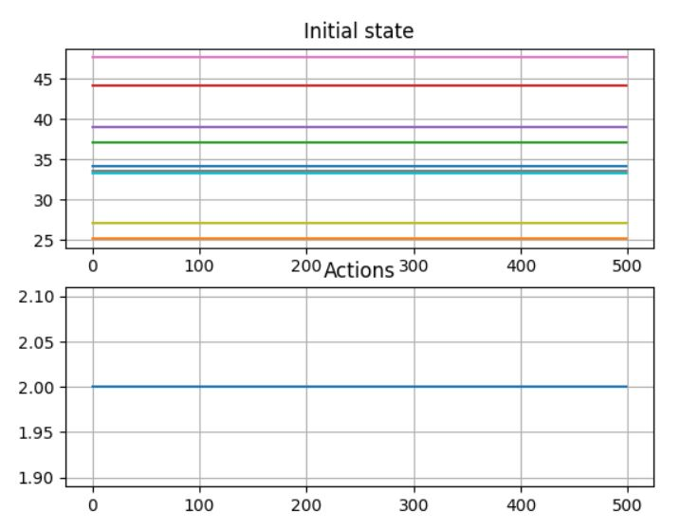
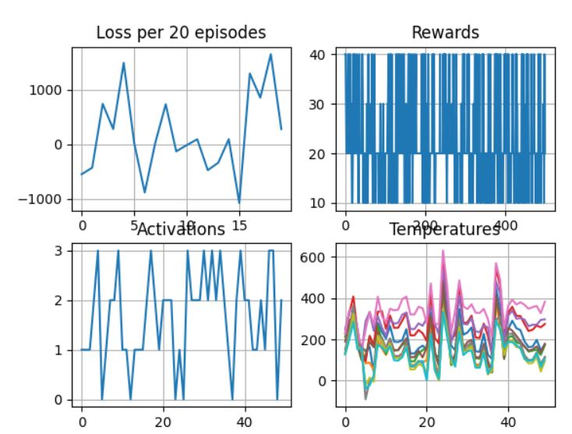
Method II – «Results»
I Phase
(train with batch data S0->Action Sequence)
II Phase
(fine-tune with REINFORCE)
TODO: try actor-critic and frame skip steps
https://rohan-v-thorat.github.io/pages/blogs/Deriving-Actor-Critic-method-along-with-some-intuition.html in progress
https://discuss.pytorch.org/t/is-there-a-way-to-combine-classification-and-regression-in-single-model/165549/2 done
Notes:
Frame skip steps paper https://arxiv.org/pdf/1605.05365.pdf: Uses only 2 possible frame skips, long short (and they call it dynamic). «The idea of dynamic length temporal abstractions in the policy space on Atari Domain has been explored by [Vafadost, 2013]. They use a Monte Carlo Tree Search (MCTS) planner with macro-actions that are composed of the same action repeated k times, for different k. The way in which our approach differs from [Vafadost, 2013] is in terms of using DQN to build neural network Q-value approximators instead of making use of search techniques that cannot generalize.”
Predict action + duration : FiGar https://openreview.net/forum?id=B1GOWV5eg
My idea: maybe choose an action, fourth one, with meaning “keep action”, so output just actions, not duration
Hold for minimum n steps : https://stackoverflow.com/questions/62562463/constraining-a-neural-networks-output-to-be-within-an-arbitrary-range (minimum duration controlling the actiovation function output)

Slide 6
Methods where the transition dynamics model is needed for evaluation:
Decision Transformer – implemented LSTM
Stitching BC
Off-policy - ConservativeQL

Slide 7
Decision Transformer
In training:
Input States, Action, Cumulative Rewards trajectories in [t]
Output Actions in [t+1]
Loss MSE
In test:
Input S0 (initial state), Total expected reward (can be higher than in batch)
Output: At each inference, for an estimated action, perform env.step()
TODO: evaluate on oven

Slide 8
Transition dynamics model
LSTM + Results
Padded CNN + LSTM – TODO
Update : NO NEED for padding
Option: directly on OVEN with Rapid Control Prototype

Slide 9
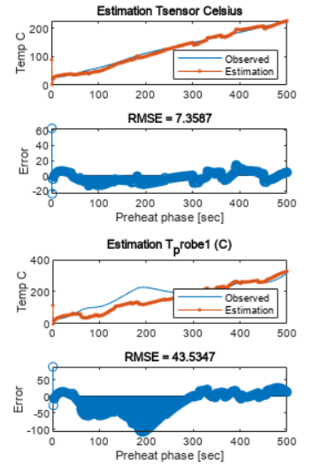
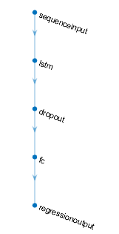
LSTM – «Results»
TODO try training on first 500 steps
UPDATE DONE – works also for less steps, 5, 10 etc.

Slide 10
Sequence dynamics model:
CNN + LSTM - Results

Slide 11
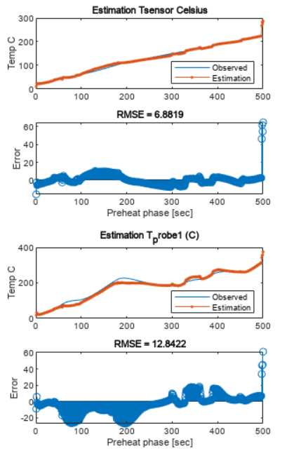
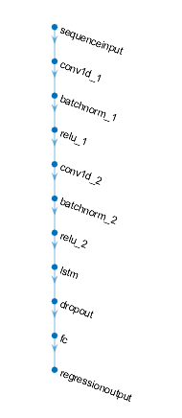
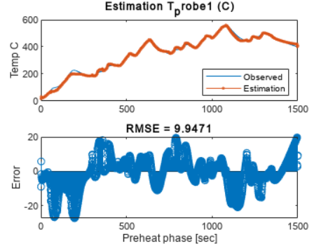
CNN + LSTM
* The model is trained on 1500 steps

Slide 12
MoM meeting Celani
2310.05808.pdf (arxiv.org)
Limits policy
Open-loop
Optimization problem, not RL
I can do non-RL and prove that its better than the RL I have tried

Slide 13
Update 17/12/2023
Do meeting with prof Celani in person
DO Predictive LSTM – input set of state output action+duration for the next set of states
DO regular RL, do state by state and show physically how the system would react for opening door, putting food etc.

Slide 14
Update 28/12/2023
Consider experience replay, https://arxiv.org/pdf/1511.05952.pdf, check drl book
Change reward function, enforce keeping one action, and try one task at a time!
Try omitting duration as output and have an action «keep» (potentially innovative) done
Continuous control? NO, PREHEAT IS DISCRETE CONTROL
RL-LSTM has nice ideas
Since environment is present (not so accurate but ok), also the Transformer, stitching can be considered still

Slide 15
TODOs from 29/12/2023
Implemented action 4, meaning «keep» previous action
Critic also with 1DCNN + LSTM (feedforward before)
TODO :
Check sysmodel for some sample action_taken sequences
Check loss implementation correctness
Find environment with similar objective, to keep a smooth increase in state value – toy example and test solution
Do step-by-step generate session, not chunks done
Check from RL-LSTM Advantage loss done and eligibility traces
Try A3C, check if it is actually implemented A3C wont do, A2C instead done

Slide 16
30/12/2023
1. appending all states to run policy (not chunk by chunk), still many to many
2. appending states but policy outputs last logit only (many to one)

Slide 17

02/01/2024
Fix actor-critic and retrain params at every step t of traj
Simplification : Try only cot temperature, not all 9
Reading papers for HVAC, multi-objective optimization
Try to model as continuing task with average reward (Data-driven control of micro-climate in buildings_ An event-triggered reinforcement learning approach)? Maybe too complex
Try reward function as
Efficient learning over large time horizons in complex environments requires hierarchical reasoning. Temporally extended actions is one such abstraction. MDPs in their conventional form do no involve actions that are temporally extended. Try SMDP?

Slide 18
03/01/2023 Past Todos collected
Simplification : Try only cot temperature, not all 9
Check loss implementation correctness corrected , 04/12 fixed to reinforce with baseline, critic is only updating at each trajectory step, it is still not implemented
Fix actor-critic and retrain params at every step t of traj
Try reward function tweaks and as
Check sysmodel for some sample action_taken sequences
Check from RL-LSTM eligibility traces
Changed Critic to MLP, input mean features from past states
Next days:
Pre-train policy with suboptimal trajectories? No, bc our suboptimal are random, maybe choosing good ones..maybe try MCAC https://drive.google.com/file/d/18kd9IvrNLeko6vYRPr2YFZMfOZGRM44g/view
Since environment is present (not so accurate but ok), also the Transformer, stitching can be considered still
Do Celani paper 2310.05808.pdf (arxiv.org)

Slide 19
05/01/2024
04/12 fixed to reinforce with baseline, critic is only updating at each trajectory step, it is still not implemented, 05/12 changed to REINFORCE Wwith baseline, where b is just the mean of the rewards of trajectories
Fix actor-critic and retrain params at every step t of traj (would do this only if within MCAC)
Reward engineering, or at least showing improvements (keepign an action, avoiding negative values…)
Check from RL-LSTM eligibility traces
Change input to Value NN
Next days:
Pre-train policy with suboptimal trajectories? Choose good ones..maybe try also MCAC https://drive.google.com/file/d/18kd9IvrNLeko6vYRPr2YFZMfOZGRM44g/view
Since environment is present (not so accurate but ok), also the Transformer, stitching can be considered still
Do Celani paper 2310.05808.pdf (arxiv.org)
Idea: drop idea of RL, do SysId as thesis, cover apollo and peregrine

Slide 20
07/01/2024
TOP PRIORITY: PRETRAIN NEEDS TO HAPPEN ON POLICY, NOT JUST UPDATING POLICY THROUGH LOSS
Fix actor-critic and retrain params at every step t of traj (would do this only if within MCAC)
Reward engineering, or at least showing improvements (keepign an action, avoiding negative values…)
Check from RL-LSTM eligibility traces
Change input to Value NN
Next days:
Pre-train policy with suboptimal trajectories? Choose good ones..maybe try also MCAC https://drive.google.com/file/d/18kd9IvrNLeko6vYRPr2YFZMfOZGRM44g/view
Since environment is present (not so accurate but ok), also the Transformer, stitching can be considered still
Do Celani paper 2310.05808.pdf (arxiv.org)
Idea: drop idea of RL, do SysId as thesis, cover apollo and peregrine

Slide 21
08/01/2024
TOP PRIORITY: PRETRAIN NEEDS TO HAPPEN ON POLICY, NOT JUST UPDATING POLICY THROUGH LOSS
OFF-POLICY IMPORTANT SAMPLING
PRETRAIN BehavioralCloning (LIKE IN THE BEGINNING, PRETRAIN IDEA)
Path Consistency Learning
PRIORITY LIMIT ACTIONS TO 2 TYPES, DONT USE ALL FOUR POSSIBILITIES IN ONE TRAJECTORY
excluded 1:[0,2400,1000], 3:[2300,0,1000]
Seems the train set contains more the 1 and 3 actions, but also noted that one of the first actions is usually 2, or 0
Normalize input sysmodel
Eliminate last states from each batch predicted, repeat instead last value
Take only first init state BAD IDEA AND REVERTED 09/01
Fixed critic MSE (previously wasnt the mean of more trajectories) PRIORITY FIX ALSO POLICY(09.01)
Normalize also output of the value network https://medium.com/mindboard/scaling-reward-values-for-improved-deep-reinforcement-learning-e9a89f89411d would need to fit scaler on set of outputs NOT DONE
Fix actor-critic and retrain params at every step t of traj (would do this only if within MCAC)
Reward engineering, or at least showing improvements (keeping an action, avoiding negative values…) change order of magnitude of rewards?
Check from RL-LSTM eligibility traces and prioritized eligibility
Change input to Value NN, take max in regions, not mean for example
Next days:
Pre-train policy with suboptimal trajectories? Choose good ones..maybe try also MCAC https://drive.google.com/file/d/18kd9IvrNLeko6vYRPr2YFZMfOZGRM44g/view
Since environment is present (not so accurate but ok), also the Transformer, stitching can be considered still
Do Celani paper 2310.05808.pdf (arxiv.org)
Idea: drop idea of RL, do SysId as thesis, cover apollo and peregrine

Slide 22
09/01/2024
TOP PRIORITY: PRETRAIN NEEDS TO HAPPEN ON POLICY, NOT JUST UPDATING POLICY THROUGH LOSS
OFF-POLICY IMPORTANT SAMPLING
PRETRAIN BehavioralCloning (LIKE IN THE BEGINNING, PRETRAIN IDEA)
Path Consistency Learning
PRIORITY LIMIT ACTIONS TO 2 TYPES, DONT USE ALL FOUR POSSIBILITIES IN ONE TRAJECTORY
excluded 1:[0,2400,1000], 3:[2300,0,1000]
Seems the train set contains more the 1 Fix actor-critic and retrain params at every step t of traj (would do this only if within MCAC) and 3 actions, but also noted that one of the first actions is usually 2, or 0 done but added only 2x2 in the beginning, not helped, check how many usually
Check outputs in matlab for actions sequences
Reward engineering, or at least showing improvements (keeping an action, avoiding negative values…) change order of magnitude of rewards? Removed reward for keeping action
Check from RL-LSTM eligibility traces and prioritized eligibility
Change input to Value NN, take max in regions, not mean for example
Next days:
Pre-train policy with suboptimal trajectories? Choose good ones..maybe try also MCAC https://drive.google.com/file/d/18kd9IvrNLeko6vYRPr2YFZMfOZGRM44g/view
Since environment is present (not so accurate but ok), also the Transformer, stitching can be considered still
Do Celani paper 2310.05808.pdf (arxiv.org)
Idea: drop idea of RL, do SysId as thesis, cover apollo and peregrine

Slide 23
Useful link
OpenAI overview of useful RL papers https://spinningup.openai.com/en/latest/spinningup/keypapers.html
PPO SO https://stackoverflow.com/questions/46422845/what-is-the-way-to-understand-proximal-policy-optimization-algorithm-in-rl

Slide 24
Points to include
or why we keep track of log probabilities instead of raw action probabilities, here is a resource that explains why and here is another.
PPO Importance sampling, TRPO KL divergence
That in this review hvac is usually for setpoint tem, actions heat vs cool, https://www.mdpi.com/1996-1073/15/10/3526 (notes on sheet of paper) instead article saved in work laptop which is on actuators actions
https://www.jmlr.org/papers/volume6/ernst05a/ernst05a.pdf tree based algorithms
semi Markov Decision Processes to induce duration of single action https://repositori.upf.edu/bitstream/handle/10230/49225/TFM_Sayan.pdf?sequence=1&isAllowed=y , https://people.cs.umass.edu/~barto/courses/cs687/Sutton-Precup-Singh-AIJ99.pdf , https://www.youtube.com/watch?v=1nuTmzqKQyE&ab_channel=PascalPoupart options concept: https://pierrelucbacon.com/deliberation-29oct2015.pdf
Deal with differences model based vs model free
Learn pessimistic model MDP https://proceedings.neurips.cc/paper/2020/file/f7efa4f864ae9b88d43527f4b14f750f-Paper.pdf and then offline
https://openreview.net/pdf?id=wiSgdeJ29ee
https://offline-rl-neurips.github.io/pdf/37.pdf pre-collected datasets to obtain policies without costly, risky, active exploration. However, commonly used offpolicy algorithms based on Q-learning or actor-critic perform poorly when learning from a static dataset. In this work, we study why off-policy RL methods fail to learn in offline setting from the value function view, and we propose a novel offline RL algorithm that we call Pessimistic Offline Policy Optimization (POPO), which learns a pessimistic value function to get a strong policy.
Sparse vs dense rewards
The rewards are unitless scalar values
Notes:
Other hvac papers explored, bad ones: https://www.mdpi.com/2411-9660/6/3/52, https://www.frontiersin.org/articles/10.3389/fenrg.2020.610518/full, https://www.sciencedirect.com/science/article/pii/S0306261920309387?via%3Dihub, https://ieeexplore.ieee.org/document/9504800, https://ieeexplore.ieee.org/document/9334865, https://link.springer.com/chapter/10.1007/978-3-319-23461-8_1, https://link.springer.com/chapter/10.1007/978-3-319-23461-8_1, event triggered https://www.sciencedirect.com/science/article/pii/S0306261920309636?via=ihub , lstm https://www.mdpi.com/2227-9717/5/3/46

Slide 25
Digital twins, heat transfer sys models
https://www.cmcc.it/projects/intertwin-an-interdisciplinary-digital-twin-engine-for-science
https://www.mdpi.com/2227-9717/10/1/21

Slide 26
Text material, tech concepts
Tesi https://bccdev.ime.usp.br/tccs/2021/artursantos/tcc.pdf OfflineRL 2021
Prudencio Survey OfflineRL 2022 https://arxiv.org/ftp/arxiv/papers/2203/2203.01387.pdf

